Slide 1
Properties of Fibber Glass
Ps-1421
Ps-1388
Ps-1355

Slide 2
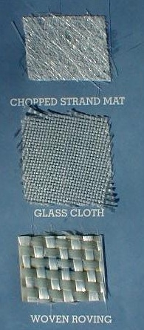
What’s Fiber?
Fiberglass is a composite material widely used in the automotive industry. It has three forms.

Slide 3
Properties of Fiberglass
low thermal conductivity.
resistance to corrosive attacks
lightweight
cheap maintenance in service
low electrical conductivity
damage and breakage resistance
aesthetical and attractive look
at temperatures below zero it doesn’t become slippery or covered with ice
hardly bendable material
low thermal conductivity.

Slide 4
Which Properties we are checking?
Thermal conductivity
Tensile Strength
Damaging and breakable opportunities
Chemical reactions

Slide 5
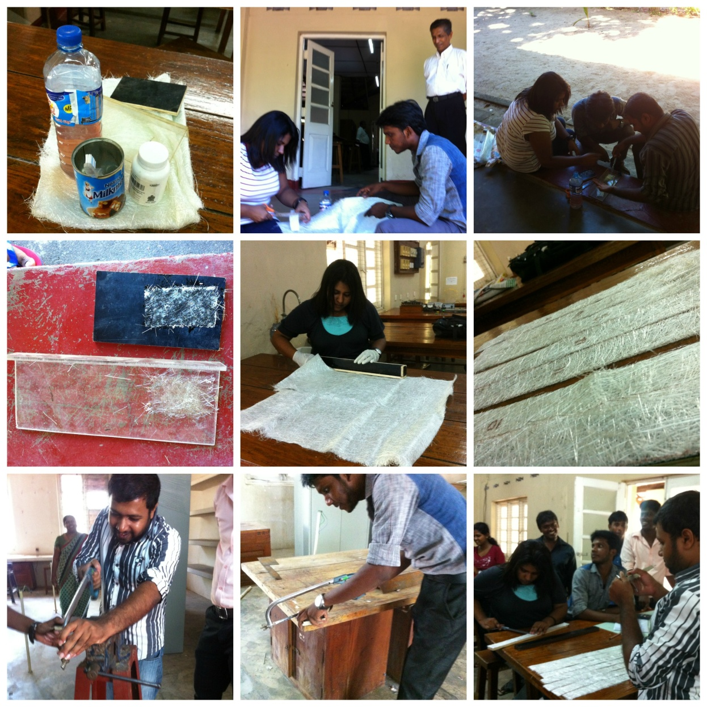
What we have done up to now?

Slide 6
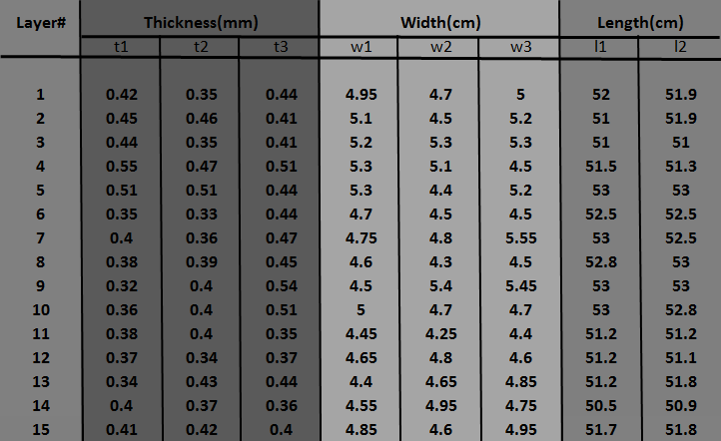
Experimental Data

Slide 7
Least Counts
Screw gauge- 0.01mm
With a negative zero error (+0.01mm)
Ruler- 0.1cm
Venire Caliper- 0.01mm

Slide 8
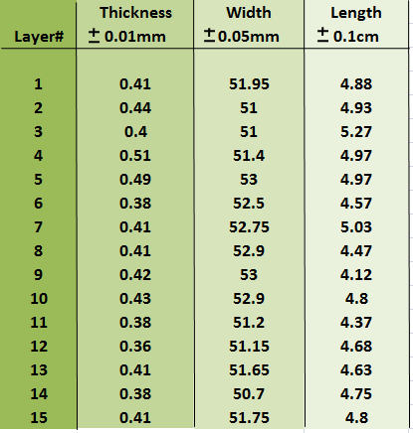
Calculated Data

Slide 9
What Should we do next?
We hope to prolong the practical to check fibber glass properties by the following practical.
Cantilever method
Chemical reactions
Damaging opportunities
Thermal conductivity

Slide 10
Cantilever bending pin and microscope
Aim
To determine the Young’s modulus of the material of fiber bar.
Apparatus
The experimental bar, rigid support with clamp, stand, weight hanger with slotted weight, pin and microscope, meter scale gauge and venire calipers.

Slide 11
Principle
Consider a rectangular bar of breath b, thickness d is subjected to cantilever bending.
The length of the cantilever which is clamped at the end A and loaded with a weight Mg at the end B is l.
The vertical depression of the loaded end of the cantilever is given by.

Slide 12
or the Young’s modulus of the material of the bar
Where AK2=bd3/12 is the geometrical moment of inertia of the bar. Thus for a mass M, the value of l3/z is a constant(Figure 1).
Traveling Microscope
Rigid clamp
l
A
Weight

